Slide 1
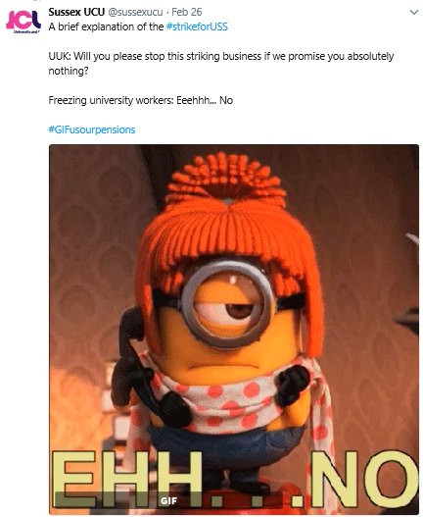
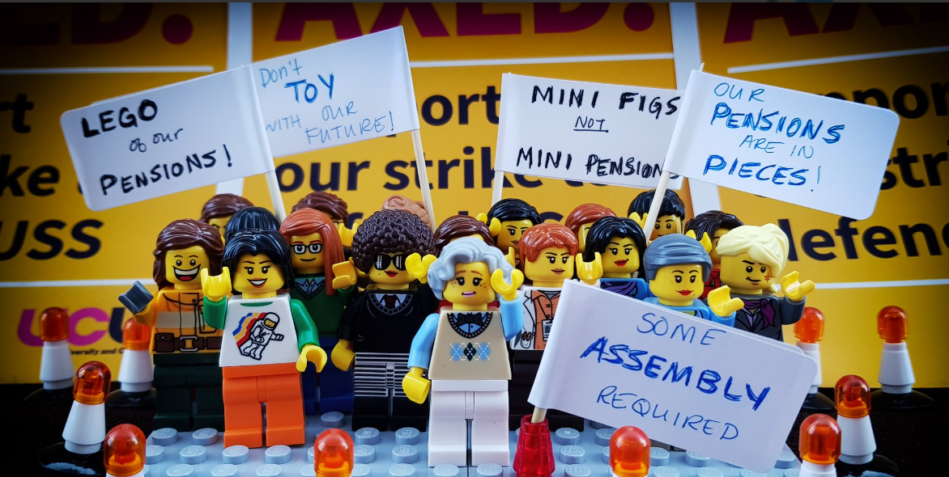

#UCUSTRIKES 2018
People were on strike because of a proposed reduction to their pension scheme.
14 days of strike action across UK universities.
An estimated 42,000 staff went on strike with 575,000 teaching hours being lost.
Students occupied university buildings in support of the strike in UCL, Liverpool, Bristol, Leicester, Bath, Exeter, Southampton, Sussex, Reading, among others.

Slide 2

Current 2019 ballot
  Inequality: black academic staff earn 12-13% less than white colleagues of the same gender and experience, and the gender pay gap is significant.
  Casualisation: large numbers of staff are employed on fix-term (non-permanent) contracts.
  Workload: many academic staff work over 50 hours a week.
  Pay: since 2009, staff pay has been effectively cut by nearly 20% in real terms
  Pensions: employers need to pay for unjust contribution increases to pension scheme, which they are trying to change.

Slide 3

What does National Union of students (NUS) say?
NUS stands shoulder to shoulder with UCU and asks its members to:
Call for higher education employers to recognise the seriousness of the situation, agree to reopen negotiations on casualisation, workload and pay inequality and put pressure on USS to implement all of the recommendations of the JEP
Write to their institution head to raise concerns about the impact such disputes will have on their learning.
Participate in local demonstrative solidarity action, both during the disputes and the likely strikes, in support of UCU members.
https://www.ucu.org.uk/UCU-NUS-jointstatement

Slide 4

University and College Union
Impact of UCU
Ensures pay and conditions are protected and improved, and that members are treated with respect in the workplace.
Campaigns and negotiates issues such as: improving pay, implementing equality policies, protecting part-time, fixed-term and hourly paid staff, tackling safety issues.
What is UCU?
Largest Further and Higher Education Union in the world.
Represents academic, academic related staff & postgraduate students working in a university, college, prison, adult education or training organisation in Further or Higher Education in the UK.
More information www.ucu.org.uk

