Slide 1
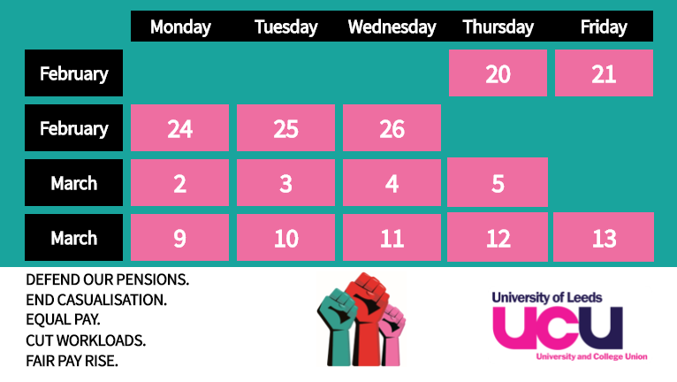
Why are we striking again?
February / March 2020

Slide 2


We strike as a last resort, because asking our employers repeatedly has not worked.
However, we continue to ask them to work with us, and hope that progress will be made as soon as possible.

Slide 3
USS Strikes Feb/March 2018
USS and Fair Pay Strikes Nov/Dec 2019
USS and Fair Pay Strikes Feb/March 2020
Past strike action has had an impact. Employers have come to the negotiating table and started to discuss ways of improving the security, equality and working conditions of staff.
But we need firmer commitments to fairer pensions, pay and conditions. The employers can end the strikes, and avoid widespread disruption for you, other staff, your families, and the
community.

Slide 4
The reasons for our 2019/2020 strikes
  We voted last year to demand action on
  Inequality: women and black and minority ethnic staff experience significant pay discrimination
  Casualisation: large numbers of staff are employed on fixed-term or hourly paid contracts.
  Workload: many staff have unsafe workloads putting in over 50 hours a week.
  Pensions: staff are paying unjust contribution increases to our pension scheme because USS are refusing to listen to experts.

Slide 5
We want:
Assurances that Universities will take concrete actions to close the gender and ethnicity pay gap, stop casualisation, and tackle excessive workloads. Recent talks have made a little progress on this but not enough.
A pay rise to help make up for a loss of pay of nearly 20% since 2009 in real terms.
A stop to increases in pension contributions. The 2018 strikes resulted in a Joint Expert Panel which has produced two reports, and talks are happening about future arrangements, but staff can’t afford the extra costs right now.
Notes:
More text on pensions in case you want to talk through this in more detail: Last year, UCU strike action saw employers shelve their plans to radically redesign the Universities Superannuation Scheme (USS). Both sides agreed to take advice from an independent panel of pension experts. The employers’ method of calculating pensions says staff need to pay more each month. The joint expert panel reached a different conclusion, based on a different method of calculating costs. We want universities to listen to the experts – other changes since 2011 mean a typical USS member stands to lose around £240,000 in retirement.

Slide 6
NUS support
Why is NUS supporting the strike?
“…We know that the student experience will always be better with satisfied staff who are able to teach and support students to their fullest ability. Currently, precarious conditions and a decline in pay exacerbated by gendered and racialised pay gaps do not allow this to happen, and so we stand together with UCU to make sure it does.”
Full article available at this link:
www.nus.org.uk/en/news/press-releases/everything-you-need-to-know-about-the-ucu-strike

Slide 7
We welcome your support
Information about how you can support us can be found on our website www.leedsucu.org.uk
We understand if you are concerned and encourage you to talk to us
Could you write to the Vice Chancellor to ask him to use his influence to push the employer bodies to negotiate meaningfully with UCU?

